Slide 1





Consumer Goods Ad_Hoc Insights Atliq Hardware
Built for performance, built for India, built for the world

Slide 2

Table of contents
01
02
03
04
Problem Statement
Objective
Problem Statement by the stakeholders
List of tasks to be completed
Analysis
Insights
Analysis of the dataset
Key takeaways from the analysis

Slide 3
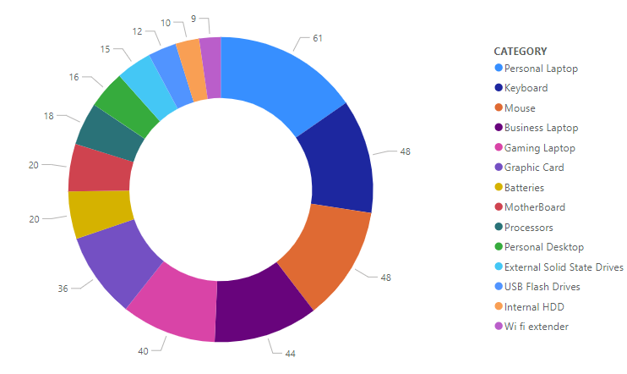
About us
FY 2020
September 2019 - August 2020
FY 2021
September 2020 - August 2021
Atliq Hardwares (imaginary corporation) is one of the leading computer hardware producers in India and well expanded in other countries too.

Slide 4
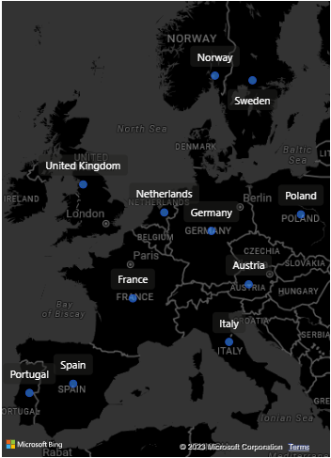
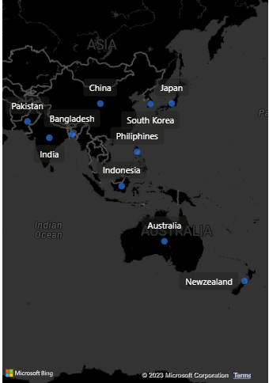
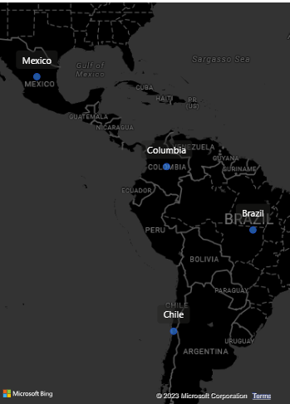
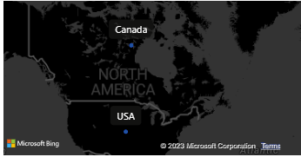
Market Presence
EU
LATAM
APAC
NA

Slide 5
Problem Statement
Atliq Hardwares (imaginary corporation) is one of the leading computer hardware producers in India and well expanded in other countries too.
The management has observed, though, that they do not receive enough information to enable them to act quickly and wisely based on facts.
They want to expand their data analytics team by adding several junior data analysts.
Tony Sharma, their data analytics director wanted to hire someone who is good at both tech and soft skills.
Hence, he decided to conduct a SQL challenge which will help him understand both the skills.
Objective of this project is to solve 10 Ad-Hoc Tasks.

Slide 6
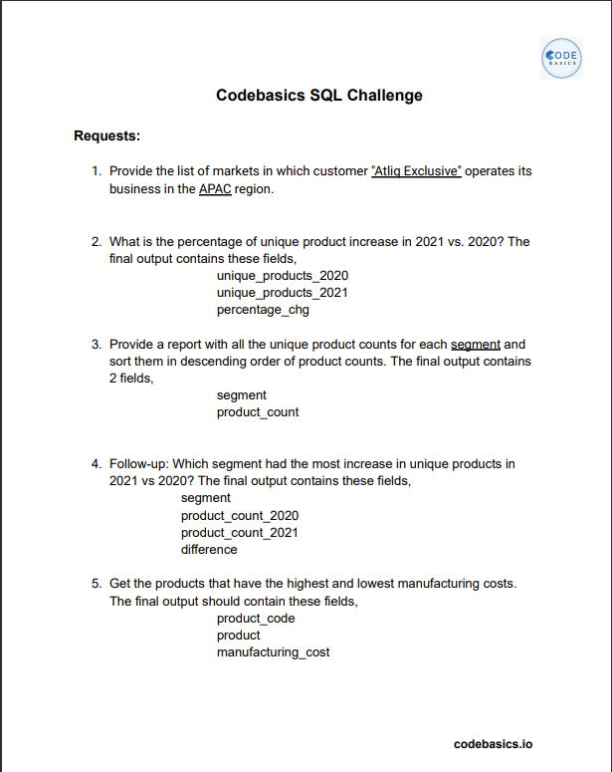
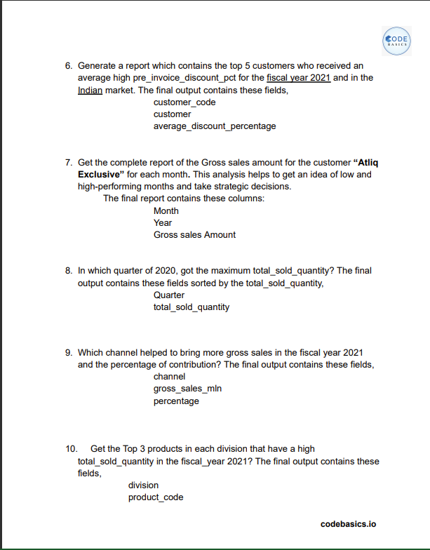
Objectives

Slide 7

Problem
How to analyze the tasks?

Slide 8
Solution
It’s simple! We could use SQL and Power BI.

Slide 9


Our team
Tony Sharma
Abhishek Shettigar
Data Analytics Director
Data Analyst

Slide 10
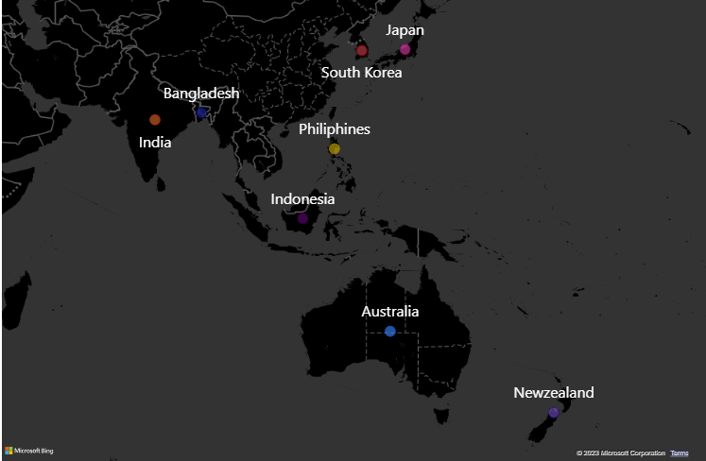
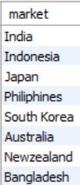
1. Provide the list of markets in which customer "Atliq Exclusive" operates its business in the APAC region.
Insights:
Understanding their geographical reach provides insights into customer base and potential expansion opportunities.

Slide 11
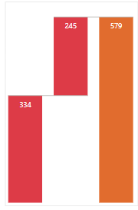
2. What is the percentage of unique product increase in 2021 vs. 2020?
% Increase from 2021 vs 2020
36.33 %
Insights:
Percentage increase in unique products between 2020 and 2021 reveals product diversification and growth strategies.
2021
2020
Total

Slide 12
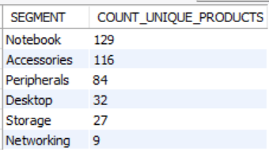
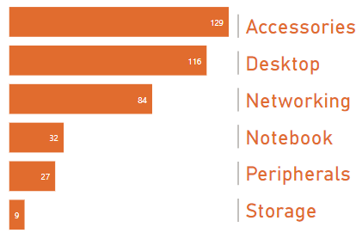
3. Provide a report with all the unique product counts for each segment and sort them in descending order of product counts.
Unique product count for each segment
Danger
Insights:
Improvement in products is may be required for the danger segments

Slide 13
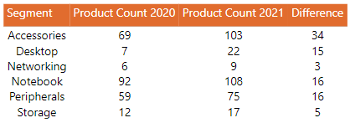
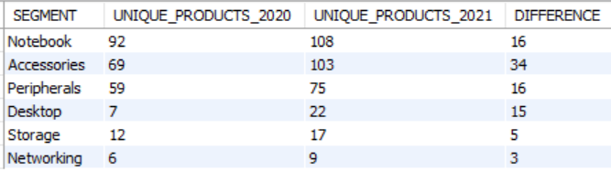
4. Follow-up: Which segment had the most increase in unique products in 2021 vs 2020?
Unique Product in 2021 vs 2020 by segment
Insights:
Identifying segments with high unique product counts and tracking their growth helps prioritize marketing and development efforts.

Slide 14
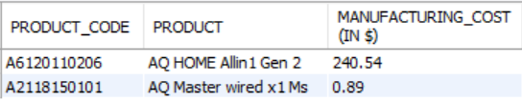
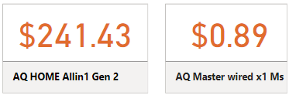
5. Get the products that have the highest and lowest manufacturing costs.
Manufacturing cost
Highest
Lowest
Insights:
Analyzing products with high and low manufacturing costs guides cost-reduction strategies and product portfolio optimization.

Slide 15
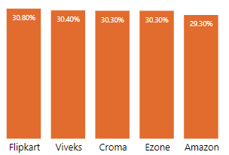
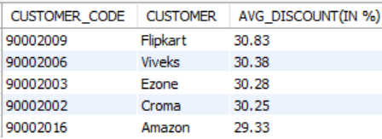
6. Generate a report which contains the top 5 customers who received an average high pre_invoice_discount_pct for the fiscal year 2021 and in the Indian market.
Top 5 customers with discount_pct for the fiscal year 2021 in the indian market
Insights:
Identifying top customers based on average pre-invoice discount reveals valuable customer segments and potential for further discounts or loyalty programs.

Slide 16
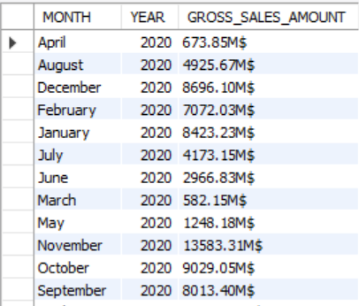
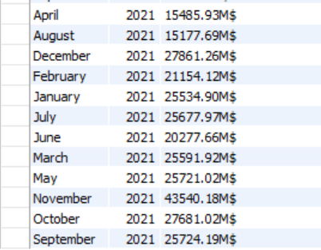
7. Get the complete report of the Gross sales amount for the customer “Atliq Exclusive” for each month. This analysis helps to get an idea of low and high-performing months and take strategic decisions.
Insights:
In 2020
Highest Sales:- November
Lowest Sales:- March
In 2021
Highest Sales:- November
Lowest Sales:- August
Calender Year 2020
63.38 B$
Calender Year 2021
299.42 B$

Slide 17
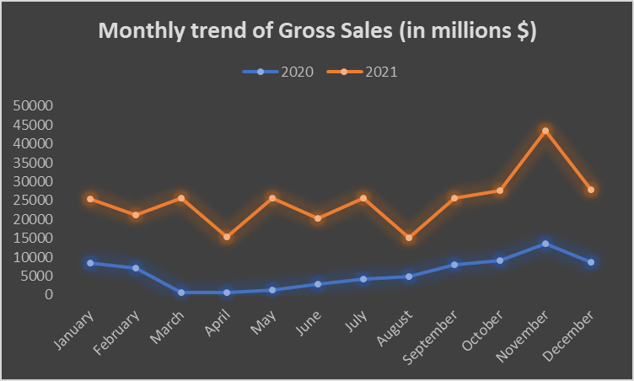
Reason: COVID-19

Slide 18
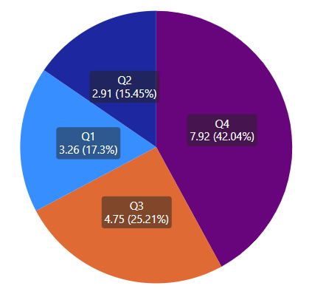
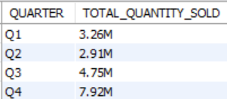
8. In which quarter of 2020, got the maximum total_sold_quantity?
Insights:
Determining the quarter with the highest total sold quantity in 2020 and the channel with the highest gross sales contribution in 2021 provides valuable insights into seasonal trends and effective sales channels.

Slide 19
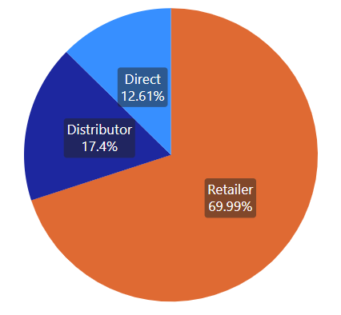
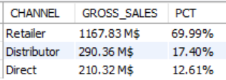
9. Which channel helped to bring more gross sales in the fiscal year 2021 and the percentage of contribution?
Insights:
The retailer channel is the most dominant, generating more than two-thirds of the company's gross sales. This suggests that the company may want to focus on maintaining strong relationships with its retail partners.

Slide 20
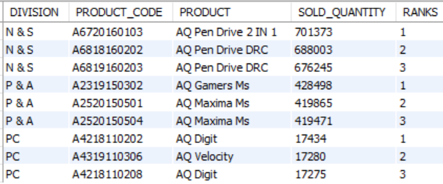
10. Get the Top 3 products in each division that have a high total_sold_quantity in the fiscal_year 2021?
Insights:
For every division, for the top 3 products, categories of products are repeating at least twice in the ranks.

Slide 21
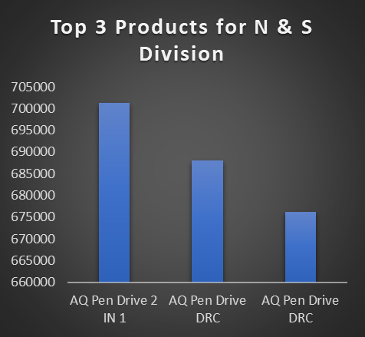
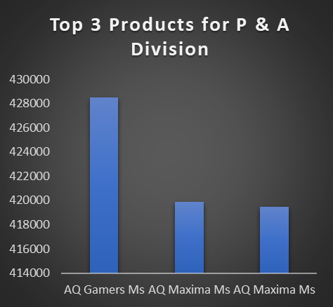
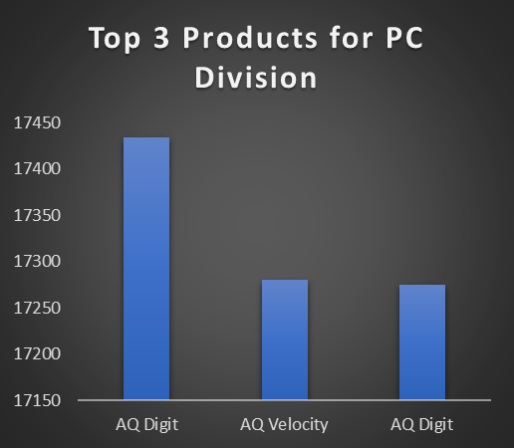
Identifying the top 3 products in each division based on total sold quantity in 2021 helps prioritize production, marketing, and sales efforts for these high-performing products.

Slide 22


Codebasics
Tony Sharma aka Hemanand Vadivel
Dhaval Patel
Thank you

Slide 23
Thanks for Attending!
LinkedIn profile:- Abhishek Ramesh Shettigar
Medium profile:-Abhishek Ramesh Shettigar
Data Analyst Portfolio:- Abhishek Ramesh Shettigar
Email:- shettigaraabhishek@gmail.com
Github:- AbhishekDataAnalyst

